Slide 1
Electron Configuration Revision

Slide 2
Welcome to this Smart Lesson about electron configurations of atoms. After you have completed this lesson, you should be able to:
State the order in which electrons fill electron shells and the number of electrons that can be found in each shell.
Draw electron shell diagrams for neutral atoms of the first 20 elements.
Write electron configurations for neutral atoms of the first 20 elements.
Explain what valence electrons are.
Identify the number of valence electrons in an atom using various methods.

Slide 3

Some elements are extremely reactive, like sodium and potassium. Others are extremely unreactive, like argon.
What determines the chemical reactivity of different elements? The answer lies in the arrangement of their electrons!

Slide 4
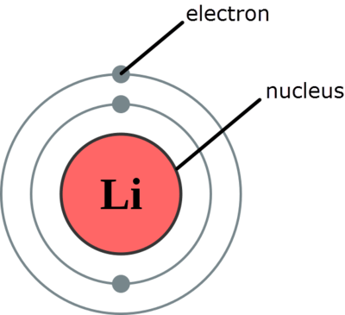
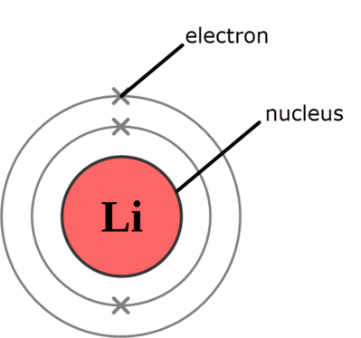
In an atom, electrons are constantly moving around the outside of the nucleus in electron shells or orbitals.
These shells are usually represented by circles in diagrams of atoms. Each shell is found at a different distance from the nucleus. Electrons are represented by either dots or crosses in these diagrams. The diagrams below show two different representations of a lithium atom which has two electrons in the first shell and one in the second shell.

Slide 5
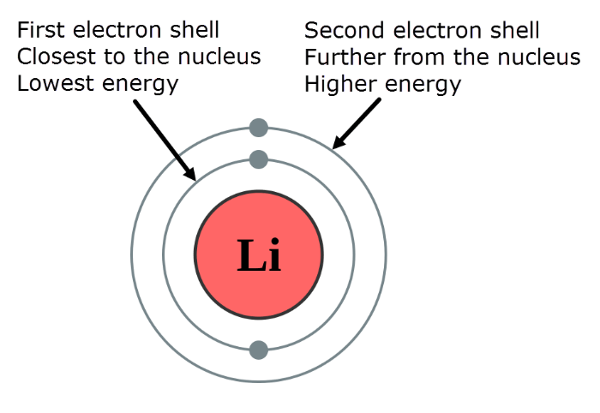
The closer the electron shells are to the nucleus, the lower their energy.
The first shell has the lowest energy, the second shell has the second lowest energy (higher energy than the first), and so on.

Slide 6

Electrons fill the electron shells starting from the shell closest to the nucleus (lowest energy level).
Each shell can only hold a certain number of electrons, so once it's full the electrons are added to the next shell, and so on.

Slide 7
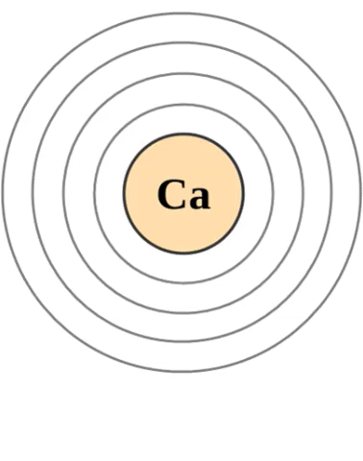
How many electrons can each shell hold?
The first electron shell (the one closest to the nucleus) can hold up to 2 electrons.
The second electron shell can hold up to 8 electrons.
The third electron shell can hold up to 8 electrons.
After all these shells are full, the electrons begin to fill the fourth electron shell. For example, the electrons in a calcium atom are arranged as shown below:

Slide 8
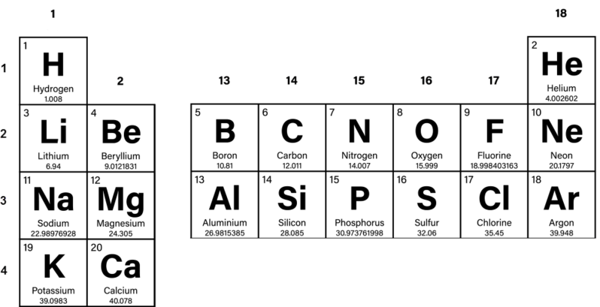
By using the periodic table, you can work out how many electrons are in an atom and therefore draw the arrangement of these electrons.
For example, could you draw the electron arrangement for a boron atom by using the information below?

Slide 9
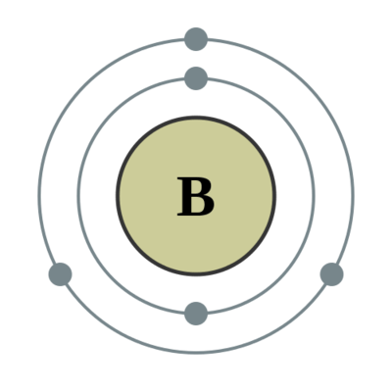
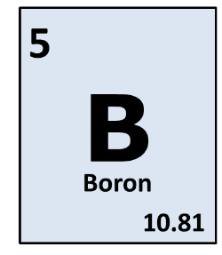
Boron has an atomic number of 5. This means there are 5 electrons in a neutral atom of boron.
The first electron shell can hold up to 2 electrons, while the second can hold up to 8 electrons. This means you would draw two electrons in the first shell, and the remaining three in the second shell.

Slide 10

The electron configuration of an atom refers to the arrangement of electrons in its shells.
Drawing out diagrams to show which shells the electrons are found in for each atom can be quite cumbersome. This is why scientists use a much simpler, shorthand method.

Slide 11
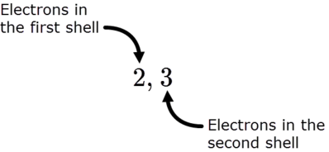
We can write the shorthand electron configuration by using numbers separated by commas. The numbers indicate the number of electrons in each shell. The commas indicate where the different shells start.
For example, a boron atom has two electrons in the first shell and three in the second shell. We write the electron configuration as 2,3.

Slide 12
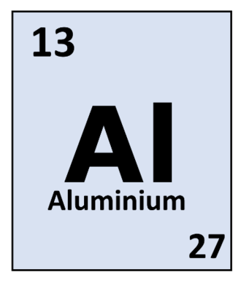
You can also work backwards from a given electron configuration to determine what the element is. For example, what is the element with the electron configuration of 2,8,3 for its neutral atom?
The total number of electrons in a neutral atom is equal to the atomic number of that element, so you can simply add up the number of electrons and then find that element on the periodic table. In this case, there are 13 electrons. The element with an atomic number of 13 is aluminium.

Slide 13


Slide 14
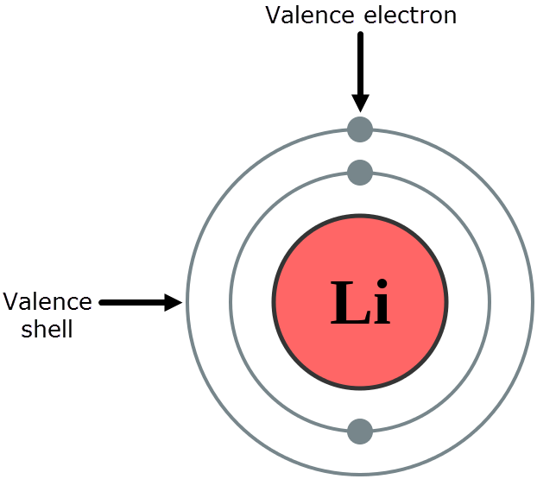
Remember how the chemical reactivity of an element depends on the arrangement of its electrons? It actually depends only on the number of electrons in the outermost electron shell.
The electrons in the outermost shell are called valence electrons and this shell is called the valence shell.

Slide 15
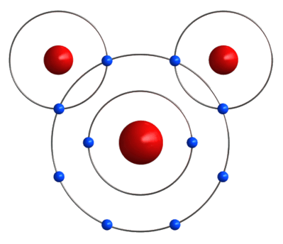
The valence electrons are the electrons that are involved in bonding and chemical reactions of atoms.
An atom is most stable when its valence shell is full of electrons, or empty of electrons. During chemical reactions, atoms will gain, lose or share electrons with other atoms in order to achieve a more stable state.
Atoms with the same number of valence electrons tend to react in the same way. You'll learn more about this in the next Smart Lesson. For now, let's focus on identifying the number of valence electrons that are present in an atom.

Slide 16
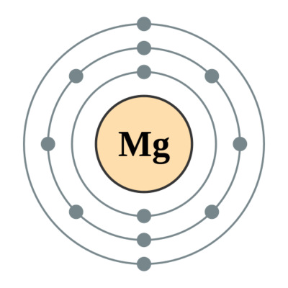
The number of valence electrons in an atom can be identified in several ways.
1. Count the number of electrons in the outer shell of a diagram or picture.
For example, the outer shell of the atom in the diagram below has two electrons in it. This atom has 2 valence electrons.

Slide 17
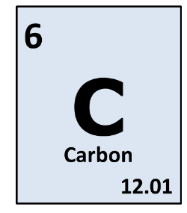
2. Take only the last number of an electron configuration.
For example, the electron configuration of a carbon atom is: C=2,4. Carbon atoms have 4 valence electrons.

Slide 18
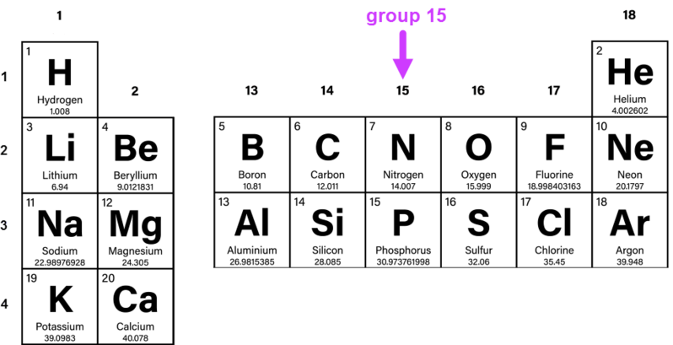
3. Identify which group of the periodic table the atom is in.
For elements in groups 1 and 2, the number of valence electrons is equal to the group number (i.e. 1 or 2 valence electrons respectively). For elements in groups 13−18, the number of valence electrons is equal to the group number minus 10 (i.e. 3−8 valence electrons respectively).
For example, nitrogen is in group 15, therefore a neutral atom of nitrogen has 5 valence electrons.

Slide 19
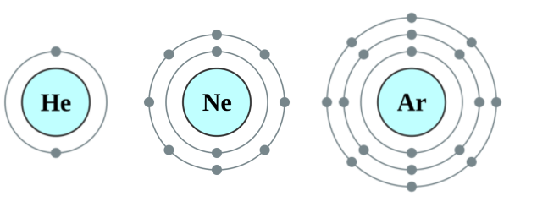
Elements in group 18 have full valence electron shells. This means they do not need to gain or lose any electrons to become stable, so they don't take part in any chemical reactions.
Helium has 2 valence electrons as its valence shell is the one closest to the nucleus. Neon and argon each have 8 valence electrons.

